Slide 1
Design Pattern Identification and Evolution in an ASP.NET Core Vehicle Rental Application
23CSE455 Design Patterns · Case Study · Team B6
Samridhi Singh · Bhavana P H · Neema Vinod · Vani Sugovind S R
Amrita School of Computing, Amritapuri · October 2026
Repository
Dependency Injection
Service Layer
Middleware Chain
Producer–Consumer
Adapter
Proxy
Strangler Fig
DTO
State
Factory Method
Strategy
Observer
Notes:
Our case study: we took a real open-source ASP.NET Core vehicle rental backend, found the design patterns already in it, evolved it with four realistic changes, and re-implemented the key patterns in four languages. The chips at the bottom are the 13 pattern instances in the final code: teal ones were in the original code, amber ones we introduced.

Slide 2
Team B6 and the case study
Samridhi Singh
Bhavana P H
Assigned case study
AM.SC.U4CSE23251
AM.SC.U4CSE23211
DOMAIN
Change1 · Fleet-maintenance scheduling
Change2 · New vehicle categories
Vehicle rental and fleet management
State
Factory Method
FRAMEWORK
ASP.NET Core 8 Web API, EF Core 8, MySQL
APPLICATION
WanderCar / Fleman — open-source FleetManagment repository on GitHub
Neema Vinod
Vani Sugovind S R
AM.SC.U4CSE23238
AM.SC.U4CSE23266
OUR SCOPE
The .NET backend (FlemanApi) and its NUnit test project
Change3 · Interchangeable pricing
Change4 · Booking notifications
SUBMISSION
Strategy
Observer
23CSE455_DP_CaseStudy / B6
Notes:
Four members, each owning one Part 2 change and the pattern it introduces. Parts 1 and 3 were team work on the same application.

Slide 3
The case study at a glance
9 → 13
4
183 → 297
4 × 5
pattern instances, original code to final code
realistic changes, each adding one GoF pattern
tests; the final code passes all 297
languages × patterns re-implemented in Part 3
1
Part 1 · Discovery
2
Part 2 · Evolution
3
Part 3 · Cross-language
LLM-assisted scan of the original code, every candidate checked against source: 9 confirmed, 3 uncertain, 9 rejected.
State, Factory Method, Strategy and Observer introduced by four changes; two real refactorings; counts and UML updated per version.
Same problem, same tests, in Java, Python, JavaScript and C++; LOC, cyclomatic complexity and run time compared.
Notes:
The whole study in one slide. The headline: the original code is rich in architectural patterns but has no behavioural GoF patterns; our four changes add one each, and nothing that was there is lost.

Slide 4
Application and architecture
01
WanderCar / Fleman — the .NET backend of an open-source vehicle rental system

Slide 5
Application, source and scope
Item | Value
Source | github.com/Naveen-verma-7697/FleetManagment, branch main
Baseline commit | dfc61ab8 (2026-08-24) “Clean up comments in IAvailabilityRepository”
Analysed | WanderCar_DotNet/src/FlemanApi and FlemanApi.Tests
Stack | ASP.NET Core 8, EF Core 8 + Pomelo MySQL, AutoMapper, FluentValidation, MailKit, QuestPDF
Tests | NUnit 3.14, Moq 4.20, FluentAssertions 6.12, EF Core InMemory 8.0.2
Environment | Windows 11 Pro, .NET SDK 8.0.425 / runtime 8.0.31, PlantUML 1.2024.8
Inspected
Controllers
Service
Repository
Data
Models
DTO
Middleware
Security
Util
Validators
AutoMapper
Program.cs
All eight functional areas of the brief: vehicles, customers, booking, pricing, billing, maintenance, notification, authentication.
Excluded
React frontend and the Java backend — not part of the .NET application; the Java service is reached only through an HTTP client.
Notes:
The baseline is pinned to commit dfc61ab8 so all line numbers are reproducible. We analysed only the C# backend; the React UI and the legacy Java backend are out of scope.

Slide 6
Layered architecture and a request flow
Repositories
Generic + Availability
MySQL 8
EF Core
Security
JWT, Google OAuth
Client
React UI / Swagger
Middleware
Exception handling, request logging
Controllers
13 REST controllers
Services
Business workflows
Email queue
Bounded channel
MailKit SMTP
hosted service
Java client
HTTP + JSON
Legacy Java
backend
Example flow — create a booking (original code)
1
POST /api/bookings passes the logging and exception middleware
2
BookingController calls IBookingService
3
BookingService validates, checks capacity and prices with RentalRateCalculator
4
GenericRepository saves through FlemanDbContext to MySQL
5
Confirmation e-mail is queued; a hosted service sends it via MailKit
Notes:
Classic layered Web API. Requests pass the middleware chain into thin controllers, which delegate to services. Services use repositories over EF Core, queue e-mail on a background channel, and reach the legacy Java backend through an adapter. The bottom row walks a booking creation end to end; this exact flow is what Changes 3 and 4 later modify.

Slide 7
Baseline build and test run
183
182
1
Build
0 warnings
0 errors
tests in the original code
passed
failed — date-dependent, not a bug we introduced
Why one test fails
Reproduce
StaffServiceTests.ProcessReturnAsync_CreatesInvoiceHeaderAndDetails
The fixture hands the car over on 2026-08-01, but StaffService bills up to DateTime.Now. Expected 40.0 (4 days), got 690.0 on the day we ran it.
This hidden clock dependency is a code smell we record here and fix in Change3.
cd B6\data\code\WanderCar_DotNet
dotnet test src\FlemanApi.Tests\
FlemanApi.Tests.csproj
Build the test project, not DotnetBackend.slnx — .slnx needs SDK 9.0.200+ and fails on SDK 8 with MSB4068.
Notes:
We ran the untouched baseline before changing anything. One test fails purely because of the date we ran it on. We kept it unchanged as a known baseline issue rather than editing the test.

Slide 8
Part 1 · Pattern discovery
02
Which patterns does the original code really contain — with source evidence for every claim

Slide 9
Discovery method: LLM proposes, source decides
1
Fix the scope
2
LLM scan
3
Check in code
4
Classify
Baseline commit dfc61ab8; file list in inspected_modules.txt
GPT-5.6 Luna on the extracted source context (2026-10-08); exact prompt saved
Roles, interfaces, calls and delegation traced in the real files
Confirmed, uncertain or rejected — each with a written reason
9
3
9
confirmed — one instance per pattern type
uncertain — structure present, intent not provable
rejected — framework APIs or naming only
Notes:
The LLM gave us 21 candidates. A class name, annotation or LLM assertion alone was never enough; we only confirmed a pattern when the collaboration was visible in the code. Only the 9 confirmed instances go into patterns.csv and the counts.

Slide 10
Pattern inventory of the original code
# | Pattern | Category | Instance | Key participants
1 | Repository | Enterprise | Generic Repository | IGenericRepository, GenericRepository, FlemanDbContext; clients VehicleService, BookingService
2 | Dependency Injection / IoC | Architectural | ASP.NET Core DI Composition | Interface → implementation bindings in Program.cs; constructor-injected services and controllers
3 | Service Layer | Enterprise | Booking Service Layer | BookingController → IBookingService → BookingService
4 | Middleware Pipeline / Chain of Resp. | Architectural | Request Middleware Chain | ExceptionHandlingMiddleware, RequestLoggingMiddleware, each calling _next(context)
5 | Producer–Consumer | Concurrency | Email Background Work Queue | EmailService → EmailBackgroundQueue (bounded Channel) → EmailQueueHostedService → MailKitEmailSender
6 | Adapter | Structural | Java Microservice Adapter | IJavaMicroserviceClient, JavaMicroserviceClient (HttpClient, Java JSON/DateTime)
7 | Proxy | Structural | Legacy API Proxy | LegacyProxyController forwards /api/legacy through IJavaMicroserviceClient
8 | Strangler Fig | Modernisation | Legacy Java Integration | JavaMicroserviceClient, JavaInvoicePdfService, LegacyProxyController, Program.cs
9 | DTO | Enterprise | API Request/Response DTO Boundary | CarDTO, BookingResponseDTO, CreateBookingRequest …; services map entities to DTOs
Totals at baseline: 9 distinct pattern types · 9 instances · source: Part1/part1_patterns.csv
Notes:
Every row has file paths in part1_patterns.csv. The catalogue is dominated by enterprise and architectural patterns that the framework encourages. Note there is no State, Strategy, Observer or Factory here.

Slide 11
Two instance records in detail
Repository
Generic Repository
Producer–Consumer
Email Background Work Queue
VehicleService
Client
BookingService
Client
EmailService
Producer — enqueues a work item
IGenericRepository<TEntity,TKey>
Repository abstraction
EmailBackgroundQueue
Bounded System.Threading.Channel
GenericRepository<TEntity,TKey>
Concrete repository
EmailQueueHostedService
Consumer — background worker
FlemanDbContext → MySQL
Persistence context
IEmailSender / MailKitEmailSender
Sends the message over SMTP
Services see only the interface; CRUD and query logic over DbSet lives in one generic class.
HTTP requests return without waiting for SMTP; the bounded channel throttles producers if the worker falls behind.
Notes:
Each confirmed instance has a record with roles mapped to actual classes and files. Two examples here. Command was proposed for the queued delegates but rejected: there is no command abstraction, so Producer–Consumer is the defensible label.

Slide 12
The other seven confirmed instances
DI / IoC
Service Layer
Chain of Responsibility
ASP.NET Core DI Composition
Booking Service Layer
Request Middleware Chain
Program.cs binds every interface to an implementation; services and controllers receive collaborators through constructors.
BookingController only delegates; BookingService owns the booking workflow and coordinates repositories.
Each middleware receives the next RequestDelegate and decides whether and when to call _next(context).
Adapter
Proxy
Strangler Fig
Java Microservice Adapter
Legacy API Proxy
Legacy Java Integration
JavaMicroserviceClient hides HttpClient and Java-specific JSON and DateTime handling behind IJavaMicroserviceClient.
LegacyProxyController exposes /api/legacy and forwards each call to the remote Java service.
Source describes the Java link as a strangler integration: invoices still come from Java while .NET takes over.
The ninth, the DTO boundary, separates request/response classes in DTO/ from the EF Core entities in Models/.
Notes:
Three of these — Adapter, Proxy and Strangler Fig — all sit on the same legacy-Java boundary but play different roles: the adapter translates, the proxy forwards a whole API, and the strangler fig is the migration strategy around both.

Slide 13
Rejected and uncertain candidates
Rejected | Reason
Factory | Only framework calls (CreateBuilder, AddScoped); no app-authored factory
Singleton | AddSingleton is a DI lifetime, not a private-constructor Singleton
Builder | Fluent WebApplication builder is framework API usage
Facade | EmailService simplifies, but no deliberate subsystem facade
Decorator | Middleware wraps a pipeline, not a component interface
Observer | OnCreatingTicket etc. are framework auth hooks
Command | Queued Func delegates, but no command abstraction or invoker
Template Method | No base class with an invariant algorithm and hook steps
State | BookingStatus / CarStatus are enums with if-rules, not state objects
Uncertain · Strategy
IInvoicePdfService has a second implementation, but it is commented out — no runtime choice.
Uncertain · Data Mapper
Mapping is done by AutoMapper (framework); DTO is confirmed instead.
Uncertain · Unit of Work
EF Core DbContext coordinates saves; no IUnitOfWork in the app.
State, Observer, Factory and Strategy were missing or doubtful here — Part 2 adds each of them for real.
Notes:
Rejections are as important as confirmations. Most were framework features that look like patterns. The interesting link: the four behavioural/creational patterns that the code lacked are exactly the extension points our changes needed.

Slide 14
Part 2 · Evolution and refactoring
03
Four realistic changes, each introducing one pattern — applied in order to the original code

Slide 15
Four changes, one new pattern each
CHANGE1
CHANGE2
CHANGE3
CHANGE4
Fleet-maintenance scheduling
New vehicle categories
Interchangeable pricing policies
Booking lifecycle notifications
Samridhi Singh
Bhavana P H
Neema Vinod
Vani Sugovind S R
State
Factory Method
Strategy
Observer
+50 tests
+24 tests
+22 tests
+18 tests
No refactoring (additive)
No refactoring (0 lines removed)
Static calculator → policy objects; injected clock
Extract Class + Move Method on BookingService
Integrated in order → Part2/code
Original
After C1
After C2
After C3
After C4
182 / 183
232 / 233
256 / 257
279 / 279
297 / 297
Notes:
Each change was developed on its own branch from the baseline, then the four were combined in folder order with one patch per step. The bottom strip shows passed over total tests at each step; the final code passes all 297.

Slide 16
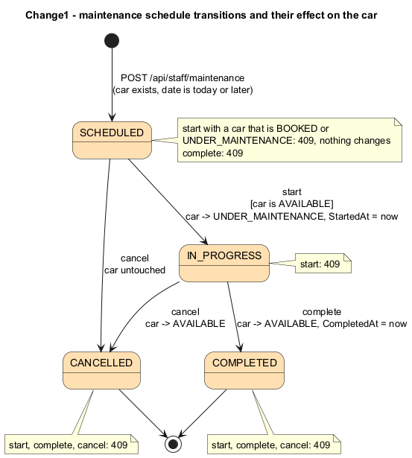
Change1 · Maintenance workflow with State
Staff schedule, start, complete or cancel maintenance for a car and list what is due or overdue. Each status is a class, so MaintenanceService has no switch on Status.
Role | Participant
State | IMaintenanceState — Start, Complete, Cancel
Default behaviour | MaintenanceStateBase — every operation → 409
ConcreteState | ScheduledState, InProgressState
Terminal states | CompletedState, CancelledState (override nothing)
Context | MaintenanceContext — picks state by dictionary lookup
Client | MaintenanceService.TransitionAsync
Result: +50 tests, 233 total / 232 passed (same baseline failure). New code takes time from an injected TimeProvider. Code in Part2/code is reconstructed from the change documents.
Notes:
The state machine on the right is the whole rule set: start only from SCHEDULED with an available car, complete only from IN_PROGRESS, cancel from either, and terminal states reject everything with 409. States are stateless singletons shared by the context.

Slide 17
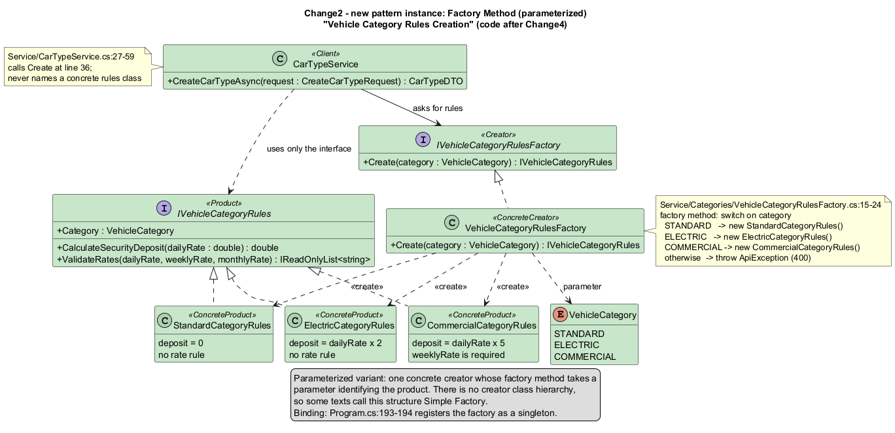
Change2 · Vehicle categories with Factory Method
Category | Deposit | Rate rule
STANDARD | 0 | none
ELECTRIC | 2 × daily | none
COMMERCIAL | 5 × daily | weekly rate required
Acceptance — all met
Existing car types report STANDARD, deposit 0
POST /api/staff/car-types stores 0 / 120 / 400 at run time
COMMERCIAL without weekly rate → 400; duplicate → 409
+24 tests; 0 existing lines removed
CarTypeService asks the factory for the rules of a category and only ever uses IVehicleCategoryRules. The switch in Create is the single place that names concrete classes.
Parameterized Factory Method — one concrete creator; some texts call this Simple Factory.
Notes:
Adding a fourth category means one new rules class and one switch arm; CarTypeService does not change. This change was purely additive: git numstat shows zero deleted lines.

Slide 18
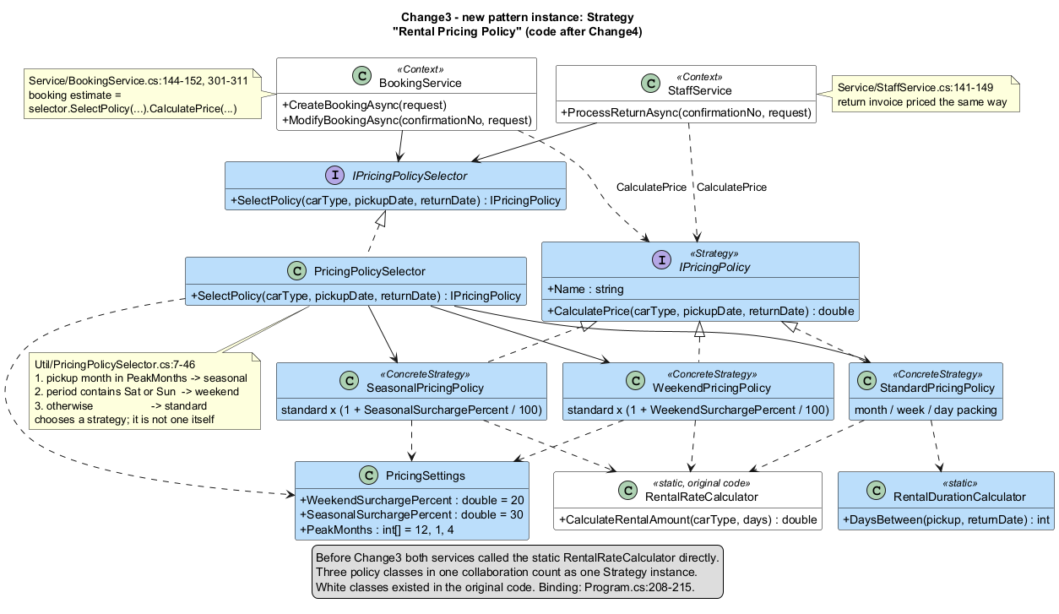
Change3 · Pricing policies with Strategy
Smell
BookingService and StaffService called the static RentalRateCalculator directly — pricing could not vary without editing both services.
Refactoring
Extract interface IPricingPolicy; three policies
Standard policy delegates to the old calculator, preserving behaviour
Inject TimeProvider into StaffService — the clock-dependent test now passes
Selector precedence: pickup in a peak month → seasonal (+30%); any Saturday or Sunday → weekend (+20%); otherwise standard. The selector chooses a strategy; it is not one.
+22 tests · 279 / 279 after this step
Notes:
This is the first change that genuinely refactors existing code. The old calculator is kept as the standard policy, so existing RentalRateCalculator tests still prove the original month/week/day packing. Injecting the clock also removes the baseline's only test failure.

Slide 19
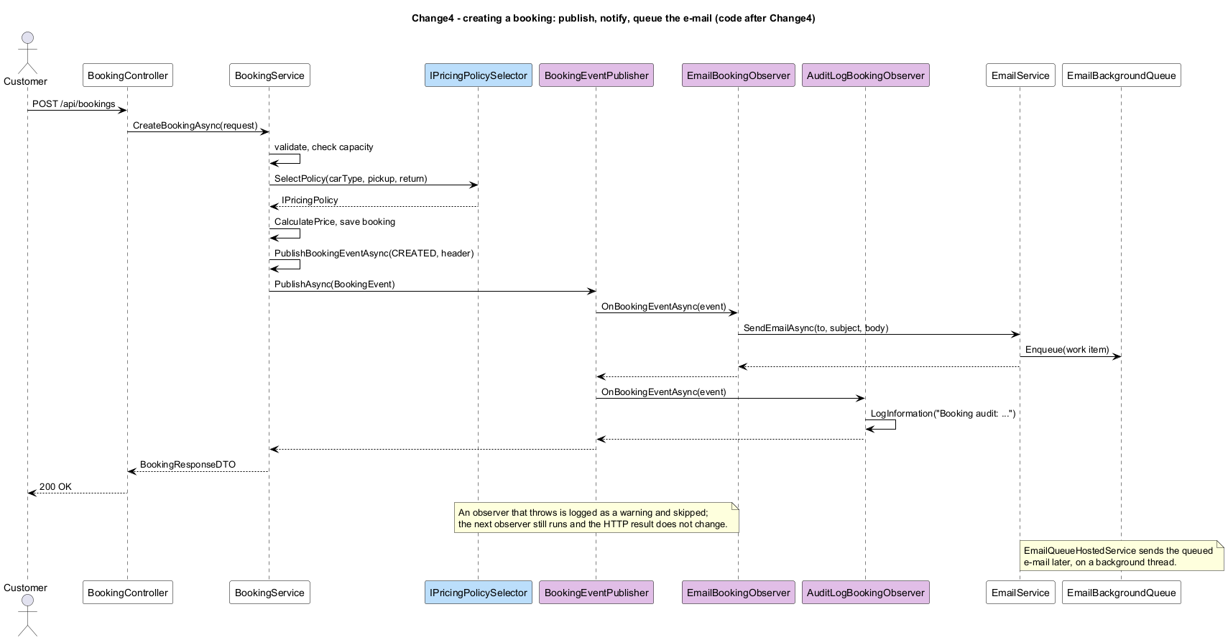
Change4 · Booking notifications with Observer
Smell
Long Method: the 123-line CreateBookingAsync ended with 30 lines that built and sent the confirmation e-mail.
Refactoring
Extract Class + Move Method into EmailBookingObserver (same e-mail text), then replace the direct call with PublishBookingEventAsync.
+18 tests; all 21 old BookingServiceTests pass, only their SetUp changed
Push model: BookingService publishes one immutable BookingEvent after each successful create, modify or cancel. A failing observer is logged and skipped; the next one still runs.
Notes:
New reactions now cost one observer class and one registration line, with no edit to BookingService. Modify and cancel get notifications for free instead of copying the e-mail block twice more.

Slide 20
Effect of each change on every instance
Instance | Original | Change1 | Change2 | Change3 | Change4
Generic Repository | baseline | extended | extended | preserved | preserved
ASP.NET Core DI Composition | baseline | extended | extended | extended | extended
Booking Service Layer | baseline | preserved | preserved | modified | modified
Request Middleware Chain | baseline | preserved | preserved | preserved | preserved
Email Background Work Queue | baseline | preserved | preserved | preserved | preserved
Java Microservice Adapter | baseline | preserved | preserved | preserved | preserved
Legacy API Proxy | baseline | preserved | preserved | preserved | preserved
Legacy Java Integration | baseline | preserved | preserved | preserved | preserved
API Request/Response DTO Boundary | baseline | extended | modified | preserved | preserved
Maintenance Schedule Workflow (State) | — | new | preserved | preserved | preserved
Vehicle Category Rules Creation (Factory) | — | — | new | preserved | preserved
Rental Pricing Policy (Strategy) | — | — | — | new | preserved
Booking Lifecycle Notification (Observer) | — | — | — | — | new
No instance removed or replaced
Counts rise 9 → 10 → 11 → 12 → 13.
DI absorbs every change
Each change only adds registrations.
Booking Service Layer modified twice
Pricing selector (C3), event publisher instead of IEmailService (C4); IBookingService unchanged.
Notes:
This matrix is pattern_evaluation.csv condensed: 55 rows, one per instance per version. Instance names are kept when the collaboration continues, as the brief requires.

Slide 21
Before and after metrics, per version
Same rule every version: non-blank, non-comment .cs lines in FlemanApi, excluding Migrations, bin and obj; tests from dotnet test on SDK 8.0.425. Original → final: 67 files changed (58 added, 9 modified), +4,545 / −52 lines including tests and migrations. Complexity, coverage and coupling were not measured for the C# code, and more LOC alone does not mean better design.
Notes:
Source LOC grows 25 percent while tests grow 63 percent. The failure count drops from 1 to 0 at Change3 because of the injected clock, not because any change accidentally fixed or broke behaviour.

Slide 22
Interpretation: what the patterns bought us
+
Benefits
±
Trade-offs
!
Limitations
New behaviour arrives as new classes, not edits — a new observer is one class and one registration
State removes status if-chains; illegal transitions fail in one place (409)
Injected clock made tests deterministic
More types and DI registrations to navigate
Factory has one creator — closer to Simple Factory
Weekend surcharge applies to the whole rental; seasonal checks pickup month only
Observers run synchronously inside the request
Change1 code reconstructed from its documents
Evolved app built and tested but not run against MySQL
Change2/4 commit hashes exist only in local clones
No complexity or coverage figures for C#
Notes:
We are careful not to claim the code is better just because it grew. The benefit is in where change happens: each new requirement touched new classes and the DI block, and the existing collaborations survived intact.

Slide 23
Part 3 · Cross-language comparison
04
One representative instance per pattern, same specification and tests in Java, Python, JavaScript and C++

Slide 24
Selected instances and common specification
Vehicle Category Rules Creation · from Change2
Measurement rules
Factory Method
7 shared test cases — deposits, COMMERCIAL weekly-rate error, unknown category
Spec: one common_spec.md per pattern; every port implements exactly it
LOC: snippet file only, no blank or comment lines, tests excluded
Max CC: 1 + each if, loop, case, catch, &&, ||
Time: compile, 1 warm-up, 5 runs, median; whole process, so start-up is included
Booking Lifecycle Notification · from Change4
Observer
8 cases — subscribe once, order, unsubscribe, failing observer isolated
DI Composition · original code, extended by Change1
Dependency Injection
10 cases — lifetimes, open generics, constructor wiring
Rental Pricing Policy Selection · from Change3
Strategy
1 self-checking example — all four print “Weekend: 360.00”
Generic Repository CRUD · original code
Repository
1 self-checking example — all four print “Repository CRUD: PASS”
Notes:
Each port comes from a real instance: Factory Method from Change2, Observer from Change4, Strategy from Change3 (standard, weekend +20% and seasonal +30% policies with the same selector precedence), DI and Repository from the original code. State from Change1 has no Part 3 port. Factory Method, Observer and DI have full test runners and measurements. Strategy and Repository each have one self-checking program per language; all eight were run on 2026-10-11 and measured with the same timing rule, but PASS there means one example ran correctly, not a test suite.

Slide 25
Results: all ports pass, structure stays the same
Median ms · max CC | Java | Python | JS | C++
Factory Method (7/7) | 110 · 4 | 57 · 2 | 70 · 4 | 15 · 4
Observer (8/8) | 239 · 9 | 65 · 3 | 71 · 3 | 17 · 6
Dependency Inj. (10/10) | 853 · 7 | 132 · 8 | 154 · 8 | 10 · 7
Strategy (1 example) | 117 · 5 | 92 · 5 | 67 · 5 | 12 · 5
Repository (1 example) | 80 · 6 | 58 · 2 | 70 · 2 | 13 · 7
All 20 ports (5 patterns × 4 languages) pass.
Times include process start-up: the JVM dominates Java, native C++ starts in ~10–17 ms.
Measured on different machines: compare within a row, not across rows.
Strategy/Repository Java, JS and C++ files put several statements per line, so their low LOC is not comparable.
Notes:
C++ is longest for Observer and DI: hand-written to_string for enum class, and templates for DI. JavaScript is shortest for DI because constructors take an explicit token list. Timings are process wall-clock, so they mostly measure runtime start-up, not the pattern. Strategy and Repository rows come from one self-checking example each; their Java, JavaScript and C++ files put several statements on one line, so their LOC in the chart is low and not comparable with Python or with the other patterns. Python's dictionary lookup in Factory Method gives the lowest CC.

Slide 26
How each language expresses the same roles
Java
Python
JavaScript
C++
Nominal interfaces checked at compile time
Exhaustive switch over an enum — a missing category is a compile error
Single-method observer interface, so lambdas work as observers
DI by reflection; type erasure forces string tokens
abc.ABC enforced only at construction; duck typing still works
Factory looks the class up in a dict — no switch
Frozen dataclass as the event
Classes are callables: impl(*deps)
No interfaces: base classes throw “not implemented”
Frozen objects stand in for enums
#private fields hold state
EventEmitter avoided — a throwing listener stops the rest
Pure virtual abstract classes, virtual destructors
unique_ptr / shared_ptr make ownership explicit
Variadic templates wire DI at compile time
enum class needs a hand-written to_string
Notes:
The participant structure is identical in every port; what differs is how much the language enforces it. Java and C++ catch role violations at compile time, Python and JavaScript rely on convention and tests.

Slide 27
LLM records and human verification
05
Every LLM-assisted step saved with prompt, input, output and an honest evaluation

Slide 28
What the LLMs did, and what we verified
Part | Model · date | Task | Evaluation
Part 1 | GPT-5.6 Luna · 2026-10-08 | Pattern discovery on source context | Checked by hand: 9 kept, 3 uncertain and 9 rejected excluded
Part 2 | Claude Opus 5.5 · 2026-10-10 | Change4 Observer code and evidence | Correct with corrections — 200/201 re-run; commit only local
Part 2 | Claude Opus 5.5 · 2026-10-11 | Integrate Change1–4 into Part2/code | Correct for what ran: 297/297; not run on MySQL
Part 2 | Claude Opus 5.5 · 2026-10-11 | Rewrite Change1 (no diff existed) | Cannot confirm as the team’s code: 50 test names match, LOC 3956 vs 3957
Part 2 | Claude Opus 5.5 · 2026-10-11 | Evolution CSV (55 rows), counts, 9 UML diagrams | Correct with limits — role mapping needs human review
Part 3 | Claude Opus 5.5 · 2026-10-10 | Factory Method and Observer ports | Correct (FM with path corrections) — logs, LOC and timings checked
Part 3 | Claude Opus 5.5 · 2026-10-10 | Dependency Injection ports | Partial — 10/10 in author layout; not re-run here
Part 3 | GPT-6 · 2026-10-11; measured with Claude Opus 5.5 | Strategy and Repository ports | Correct for what ran — all 8 exit 0; first CSV rows replaced by measured values
Prompts: Part1/Part1_prompt.txt · Part2/part2_prompt.txt · Part2/changes/Change4/prompt.md · Part3/llm/part3_prompt.txt — records in each part’s llm.csv
Notes:
We used LLMs as assistants, never as the authority. Every claim was re-run or traced to code, and where we could not confirm something we say so in llm.csv instead of upgrading it.

Slide 29
Findings and contributions
06
Evidence-supported conclusions, who did what, and references

Slide 30
Findings
1
Framework-shaped baseline
2
Missing patterns were the extension points
All 9 confirmed instances are enterprise, architectural or integration patterns — no behavioural GoF pattern was present.
State, Factory Method, Strategy and Observer — rejected or doubtful at baseline — each solved one real requirement.
3
Existing patterns absorbed change
4
Refactor where the smell is real
No instance removed or replaced; DI extended by every change, Repository gained clients without edits.
Two refactorings: static pricing coupling with a hidden clock (C3), and a long mixed-responsibility method (C4).
5
Tests prove behaviour kept
6
Roles are language-independent
183 → 297 tests, all passing; the one baseline failure was a clock dependency fixed by injection.
Four languages, same participants and tests; language features change LOC and CC, not the pattern.
Notes:
Six evidence-backed conclusions. The strongest one is finding 2: the patterns we rejected in Part 1 for lack of evidence were exactly the ones the new requirements called for.

Slide 31
Contributions and team folder
Roll number | Name | Contribution
AM.SC.U4CSE23251 | Samridhi Singh | Change1: maintenance scheduling, State pattern, 50 tests
AM.SC.U4CSE23211 | Bhavana P H | Change2: vehicle categories, Factory Method, 24 tests
AM.SC.U4CSE23238 | Neema Vinod | Change3: pricing policies, Strategy, refactoring, 22 tests
AM.SC.U4CSE23266 | Vani Sugovind S R | Change4: booking notifications, Observer, refactoring, 18 tests
B6/
├ README.md
├ data/
│ ├ code/ original (dfc61ab8)
│ └ test_result/
├ Part1/
│ ├ part1_patterns.csv
│ ├ part1_pattern_count.csv
│ ├ pattern_architecture/
│ └ Part1_prompt.txt, llm.csv
├ Part2/
│ ├ code/ evolved source
│ ├ changes/Change1…4, integration/
│ ├ pattern_evaluation.csv
│ ├ Pattern_count.csv, diagrams/
│ └ part2_prompt.txt, llm.csv
└ Part3/
├ Factory_Method/, Observer_Pattern/
├ Dependency_Injection_Pattern/
├ strategy_pattern/
├ repository_pattern/
└ llm/
Parts 1 and 3, the integration and the report were shared team work.
Notes:
Each member's Part 2 change is traceable to its own folder with requirement, diff, pattern effects, refactoring, metrics and test logs.

Slide 32
References
Application: Naveen-verma-7697/FleetManagment, GitHub, commit dfc61ab8 (accessed Oct 2026)
Submission: aswathymohan-amrita/23CSE455_DP_CaseStudy, folder B6
Gamma, Helm, Johnson, Vlissides — Design Patterns: Elements of Reusable Object-Oriented Software, 1994
Fowler — Patterns of Enterprise Application Architecture, 2002 (Repository, Service Layer, DTO, Unit of Work)
Fowler — “Strangler Fig Application”, martinfowler.com
Microsoft Learn — ASP.NET Core dependency injection, middleware, hosted services, System.Threading.Channels, TimeProvider
Tools: .NET SDK 8.0.425, NUnit 3.14, Moq, FluentAssertions, PlantUML 1.2024.8, lizard
LLMs: GPT-5.6 Luna (Part 1); Claude Opus 5.5 in Claude Code (Parts 2 and 3); GPT-6 (Part 3 Strategy and Repository)
Notes:
Pattern definitions follow GoF for State, Factory Method, Strategy, Observer, Adapter and Proxy, and Fowler for the enterprise patterns.

Slide 33
Thank you
Questions? · Team B6
Repository
Dependency Injection
Service Layer
Middleware Chain
Producer–Consumer
Adapter
Proxy
Strangler Fig
DTO
State
Factory Method
Strategy
Observer
Notes:
Thank you. Happy to show any instance record, diff or test log from the repository.

